Slide 1
Week 6
Data Modeling & Transactions

Slide 2
Lesson 13
Inserts and Updates

Slide 3
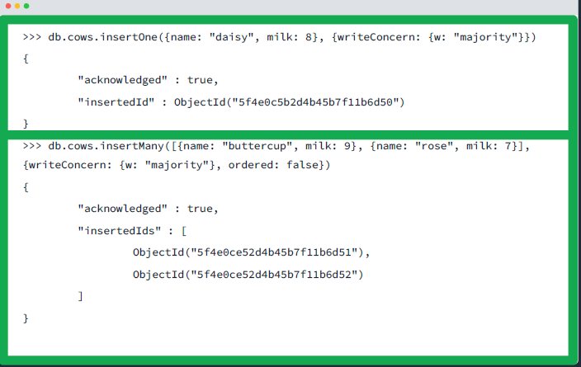
MQL Create
insertOne()
Insert one document into a collection.
insertMany()
Insert an array of documents into a collection.
Mongo will attempt to write these documents in parallel increasing write speed over insertOne() for multiple documents.
writeConcern
Sets the level of acknowledgment requested from MongoDB for write operations.
Ordered
For insertMany() there is an additional option for controlling whether the documents are inserted in ordered or unordered fashion.

Slide 4
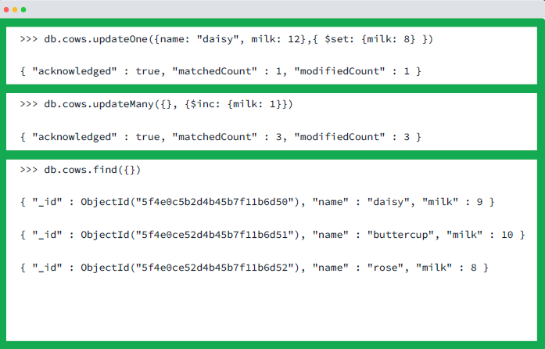
MQL Update
updateOne()
Update one document into a collection.
updateMany()
Update an array of documents into a collection.
The filter option will update all documents matching the criteria.
The bulk_write method will allow you to create multiple updateOne statements without using the same filter for the many statement.
Upsert
Used when the document isn’t’ found in the collection to insert it as a new document.

Slide 5
Considerations
Bulk operations
Its generally more performant to limit the number of bulk transactions on the DB.
Write concern
Sets the durability during the write. We talked about eventual consistency on replica sets, but this sets the number of replica sets written on the initial write.
Ordering
The ordering of the write impacts performance. Essentially the data may need to be shuffled in order to write in the order specified.
Unordered writes
These are done in parallel which boosts write performance.

Slide 6
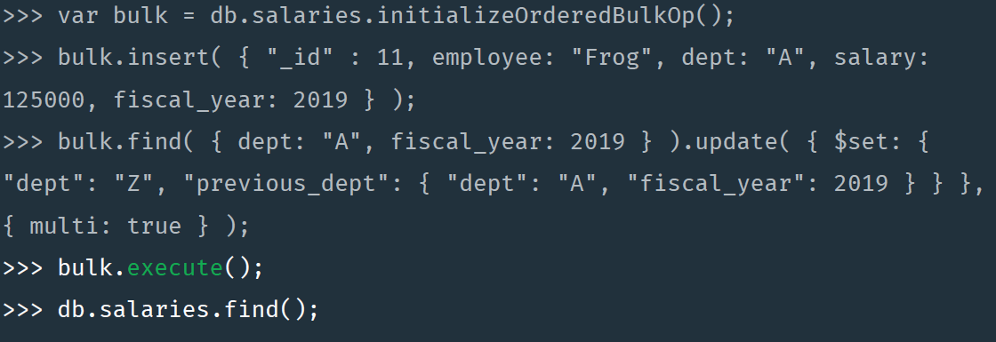
Bulk API
Allows you to combine different operations
Write, delete, update operations
By default uses ordered operations and the default write concern but these are configurable.

Slide 7
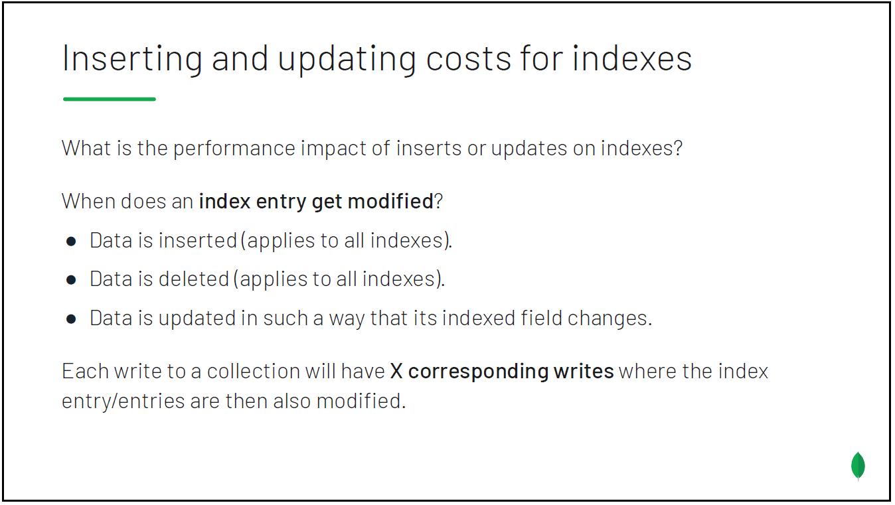

Slide 8
Lesson 14
Deleting Data in MongoDB

Slide 9
Deleting Documents
Delete all documents
Use collection.drop() which deletes the associated indexes
Delete individual or subset of documents
Age the data out using TTL indexes
Data becomes expired after a certain age.
Considerations
Vastly more performant to delete on the indexes

Slide 10
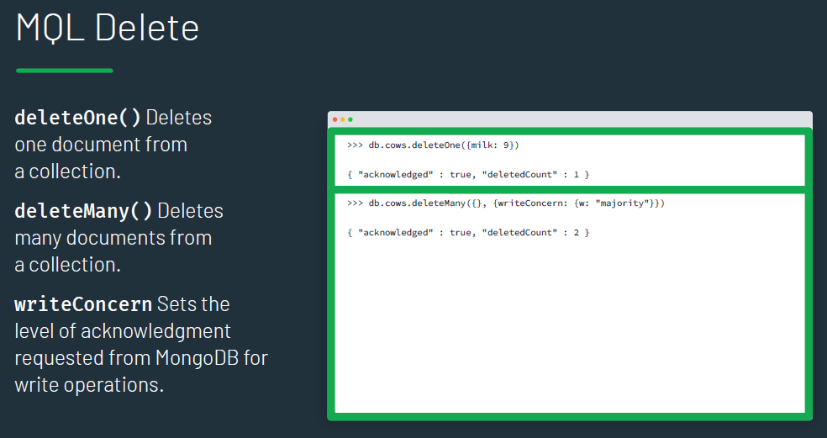

Slide 11
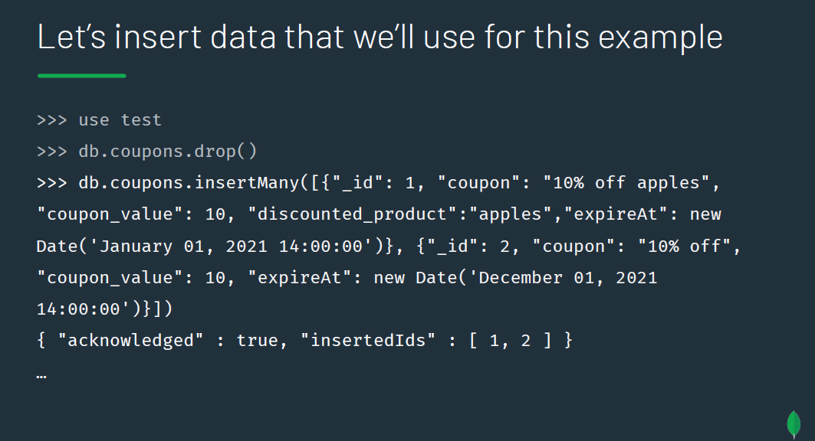
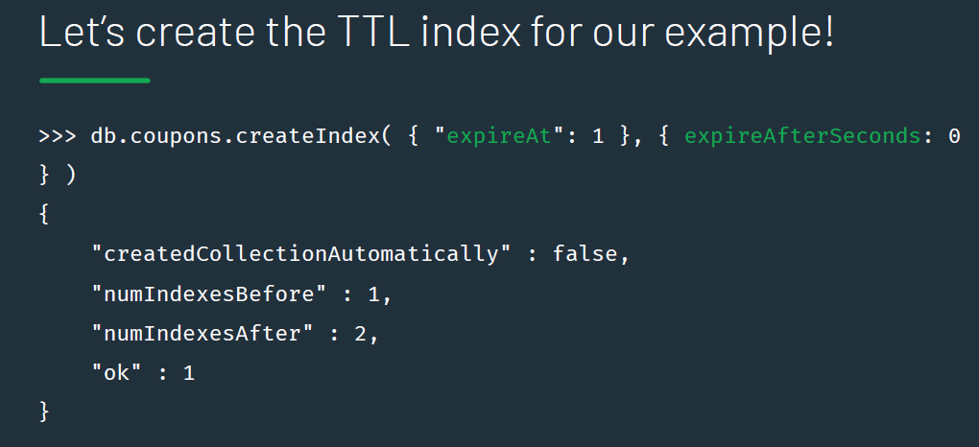
Time to Live Indexes (TTL)
Single field index
Only documents within the index will be deleted
Documents will expire and be deleted after a certain time threshold
either they can delete the documents after a set period of time or they can be deleted at a specific clock time
A background task runs every 60 seconds to monitor the index and will remove any documents that hit the threshold

Slide 12
Lesson 17
Data Modeling and Schema Design Patterns

Slide 13
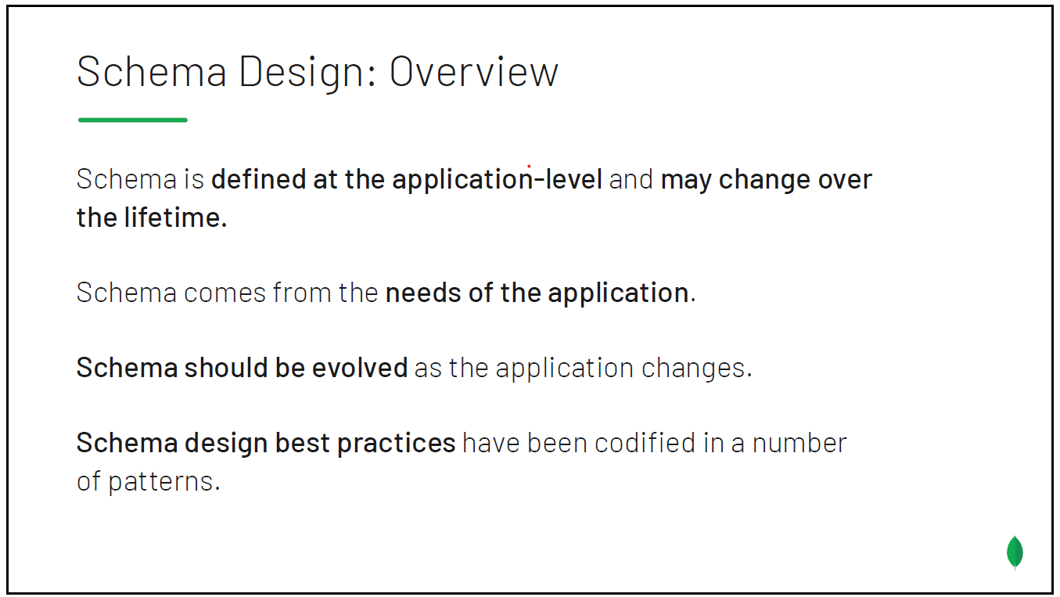

Slide 14
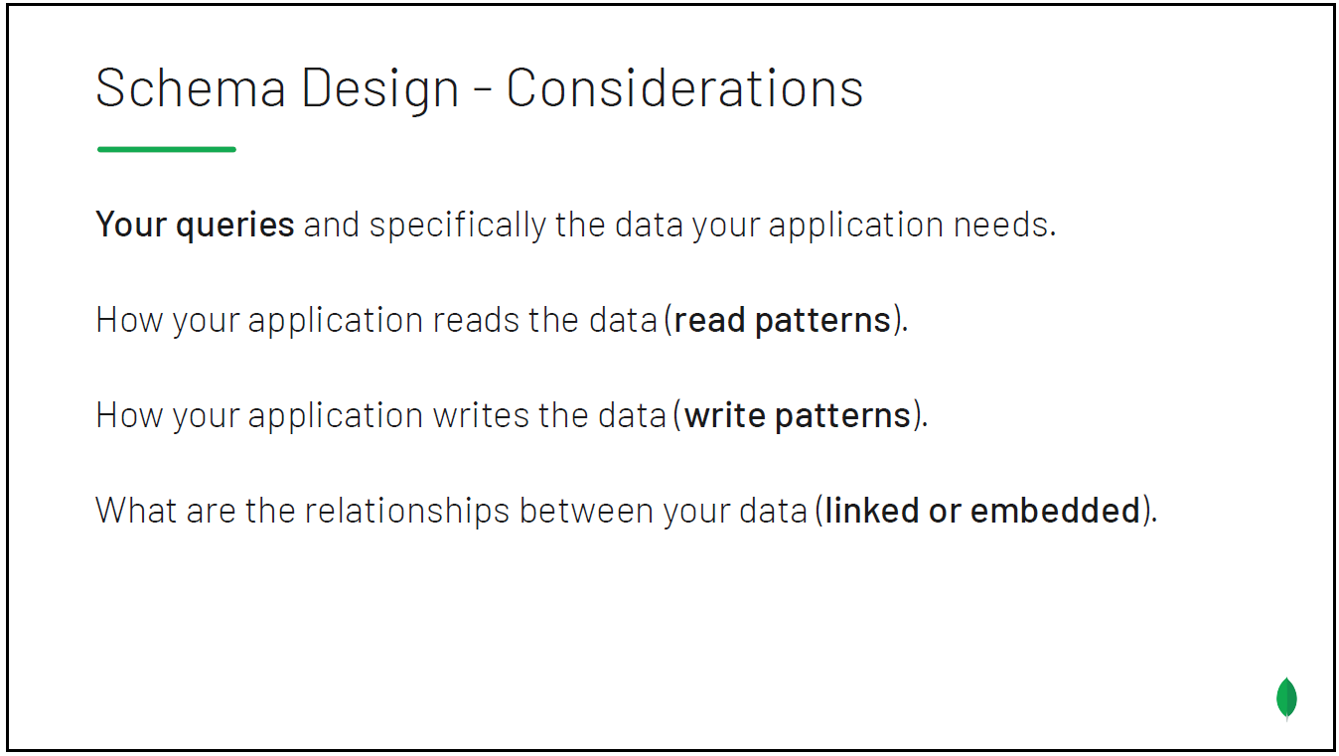

Slide 15
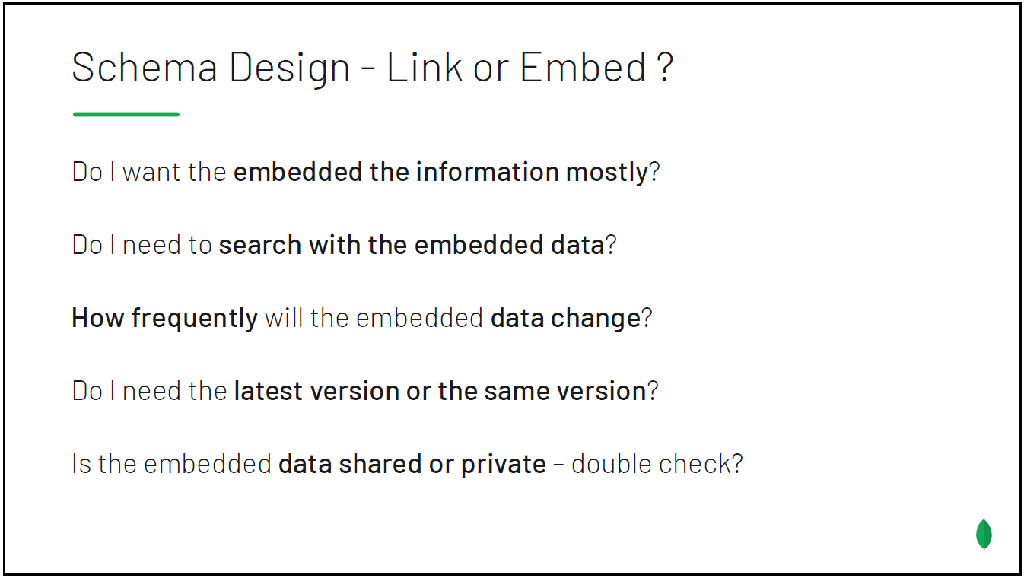

Slide 16
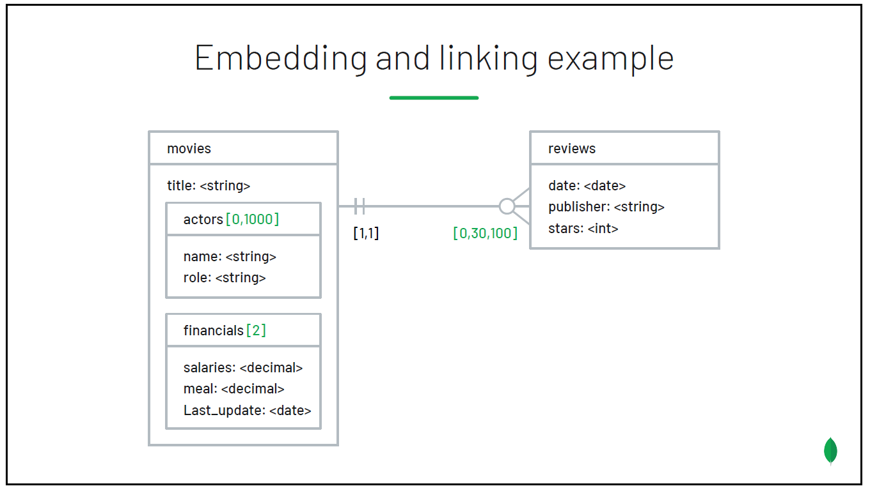

Slide 17
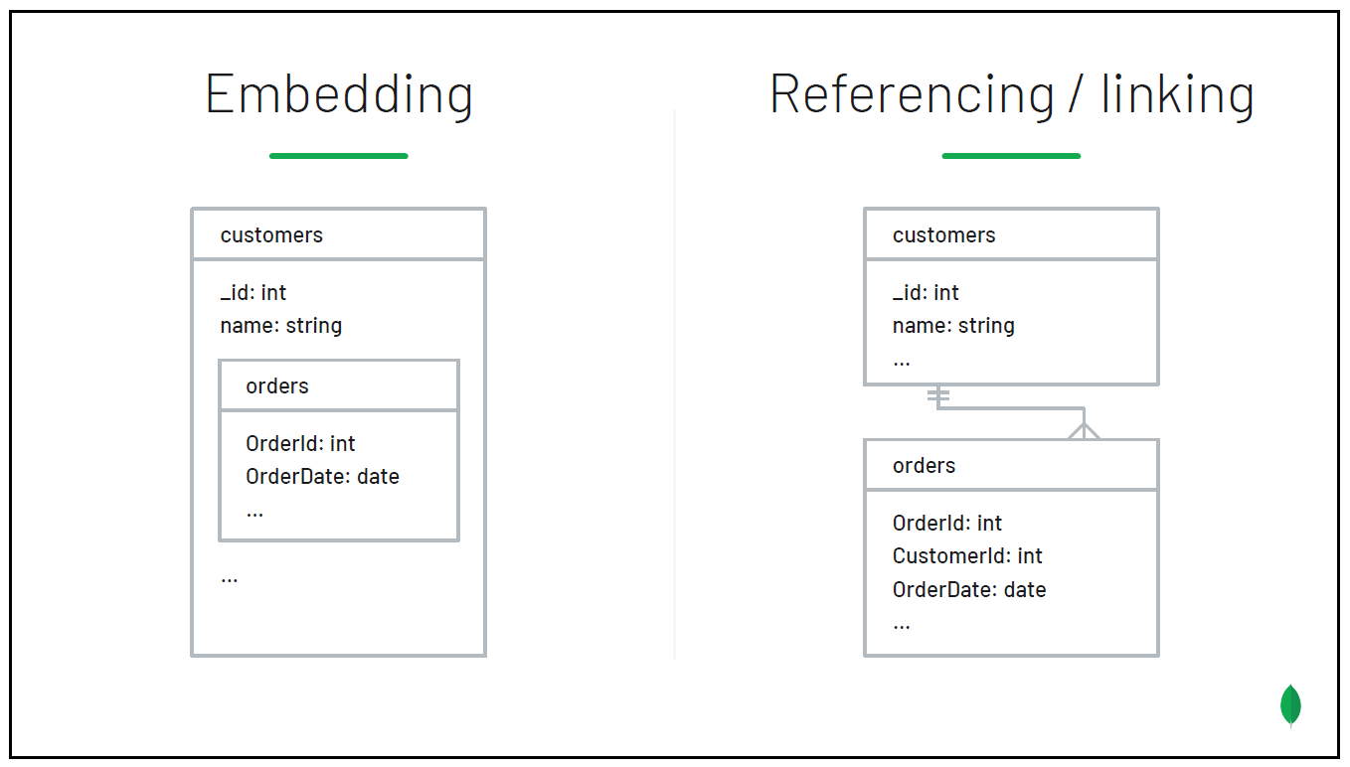

Slide 18
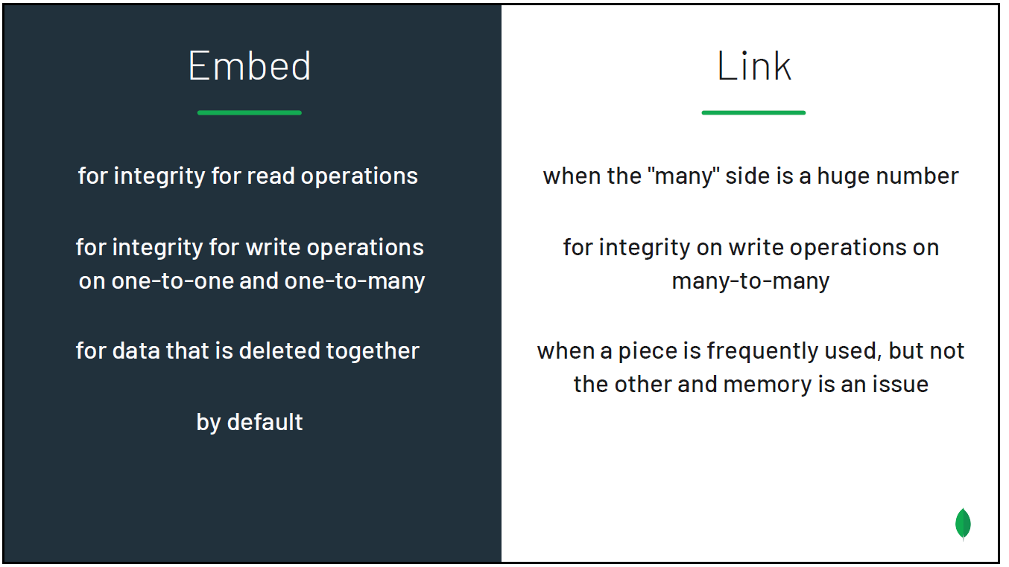
Embedded Relationships
One – to – One
Documents can be contained at the same level of the document
One – to – Many
The documents containing the many relationship would need to be treated as an array.
Many – to – Many
Multiple embedded arrays (duplicates) for one side of the relationship.

Slide 19
Lesson 18
Sharding

Slide 20
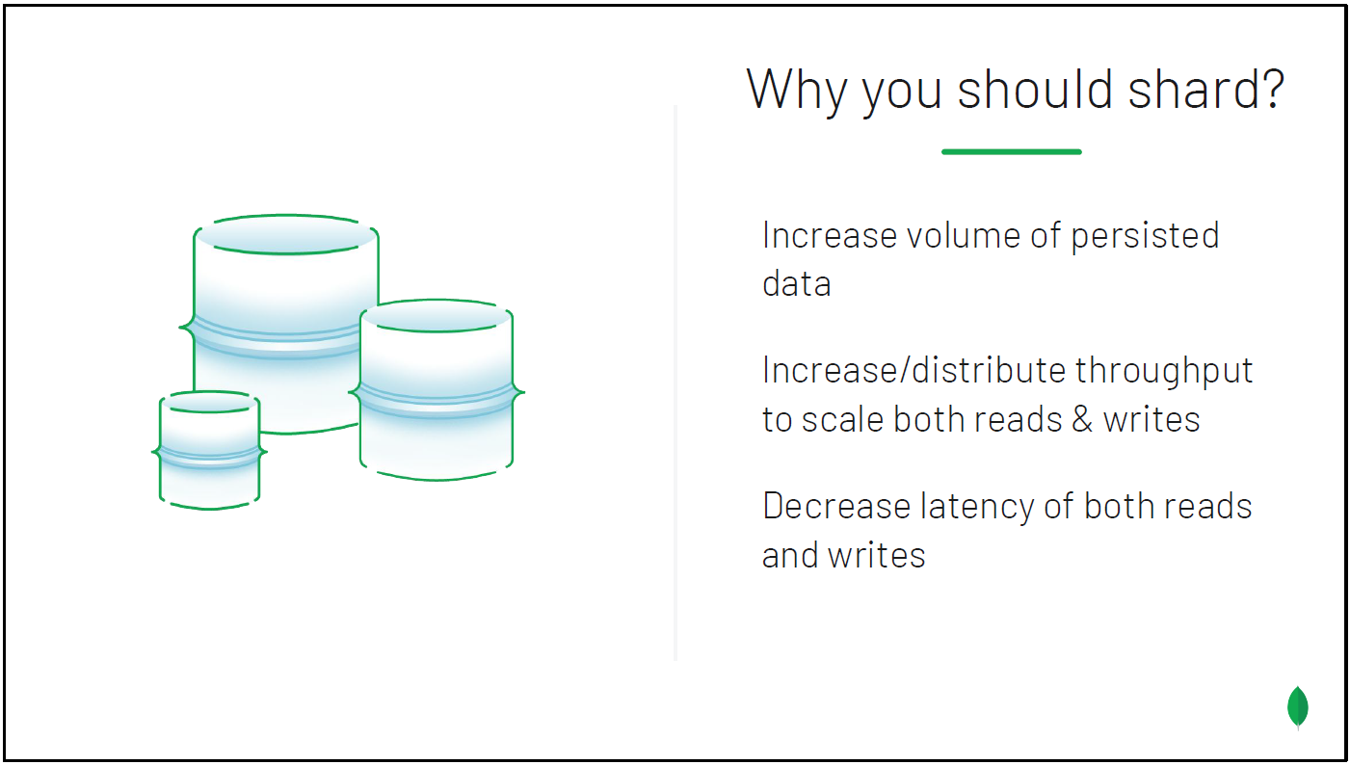

Slide 21
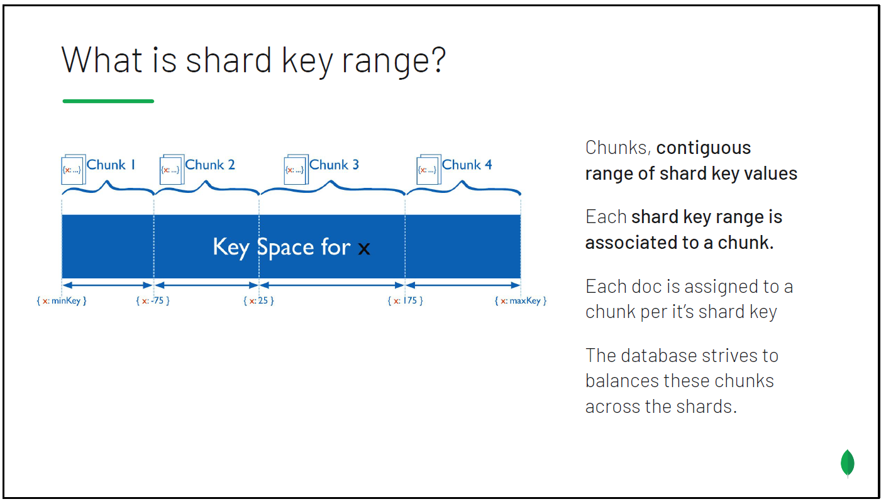
Notes:
The shard key is either an indexed field or indexed compound fields. It defines a space of values like points on a line. Key ranges are segments of that line.
The shard key is used to route operations to the appropriate shard. The shard key is used for reads and also for writes.

Slide 22
Considerations for a Good Shard Key
Cardinality
How well the shard key can be broken into smaller groups.
Write Distribution
Design to evenly distribute writes
Read Distribution
Design to evenly distribute reads
Read Targeting
Design your read to use a shard key that can target an individual shard
The shard key should avoid scatter/gather where all shards need to be queried in order to return a result
Read Locality
Balance read targeting against read locality in certain cases
Idea of a compound shard, larger shard with a sub-shard within the same chunk
Index Locality
This relates to how RAM needs to be considered with large data sets in terms of how it is indexed and how the index needs to be created in a way that the entire index will not be scanned, only the portion involved with the shards in question.
General considerations
The shard key needs to be used in the majority of your queries
The shard key needs to collate data you commonly query together

Slide 23
Lesson 19
Indexing

Slide 24
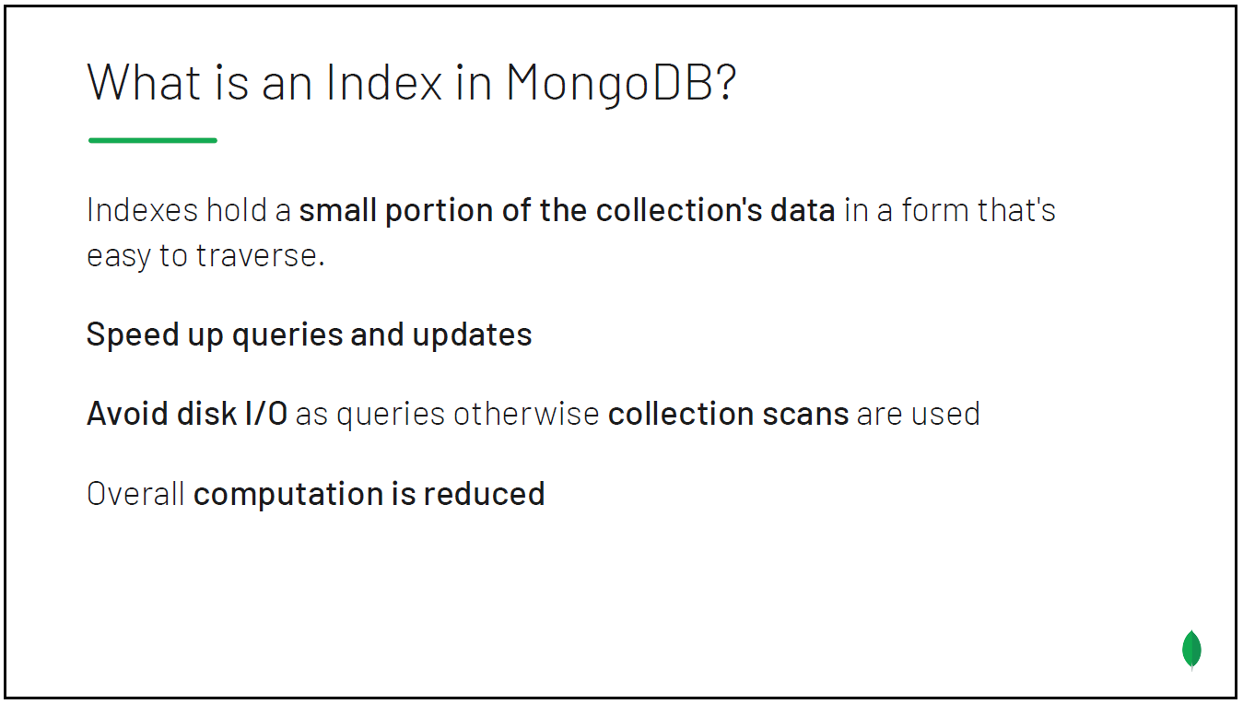

Slide 25
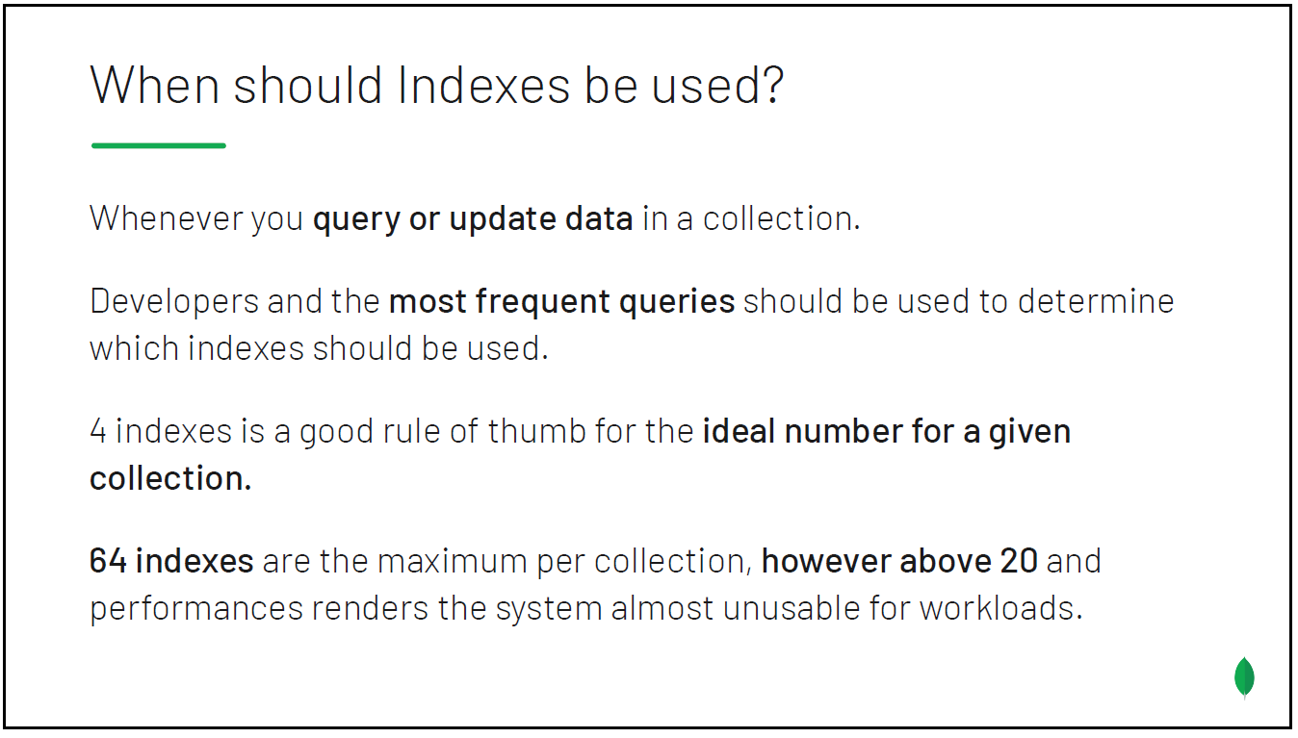

Slide 26
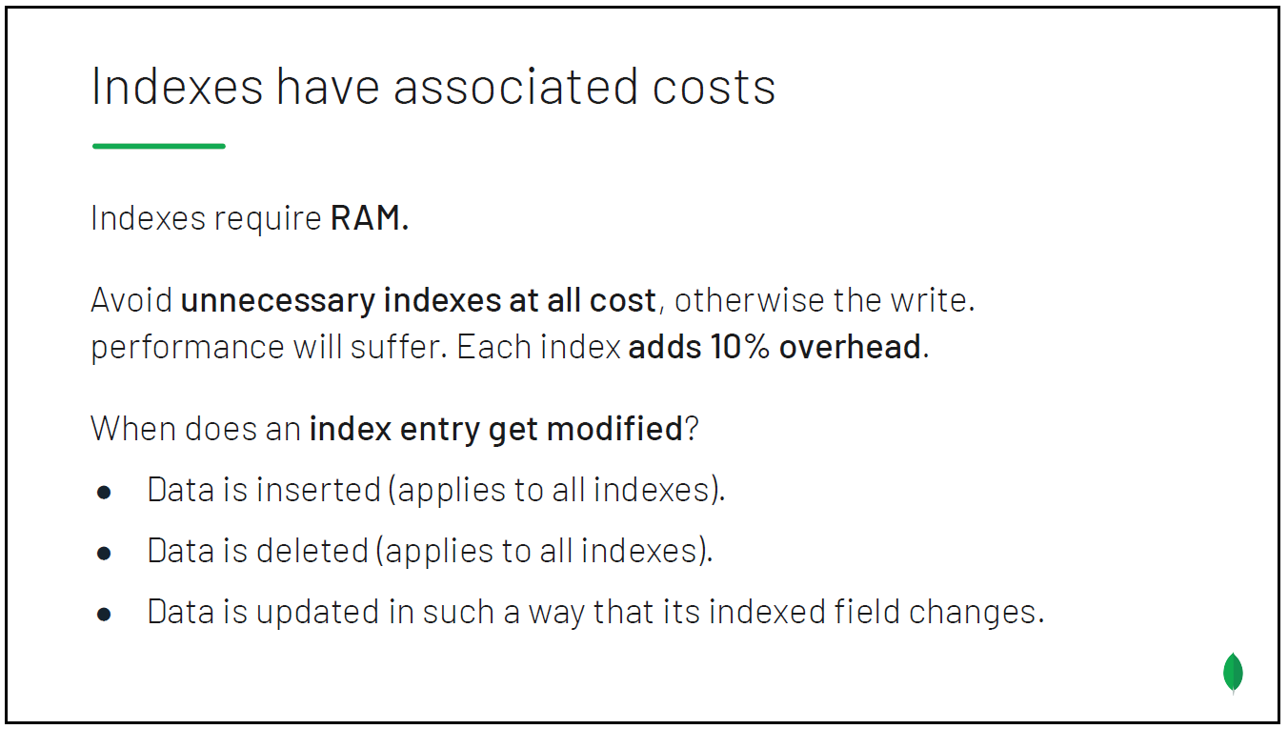

Slide 27
